Slide 1
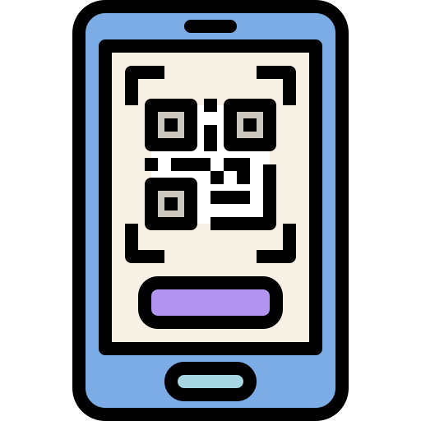


SCDF Emergency QR
Team 108 Devs
Daniel Kwang, Joshua Lim, Charles Goh, Ernest Oh, Henry J.

Slide 2
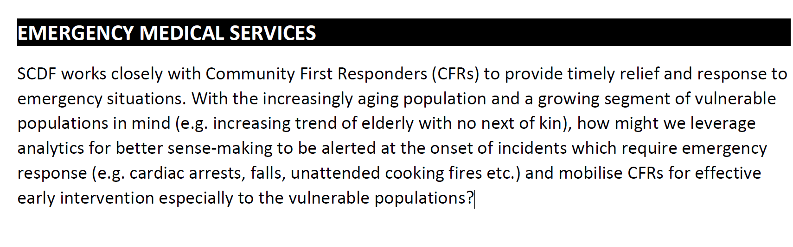
Chosen Problem

Slide 3
Current problems (Emergency/Non-emergency Response)
False alarm: https://www.scdf.gov.sg/docs/default-source/scdf-library/amb-fire-inspection-statistics/scdf-annual-statistics-2019.pdf
Slow response: Hard to describe location
Poor description of situation
No information on persons at risk
Don’t know how to perform CPR, life saving techniques

Slide 4
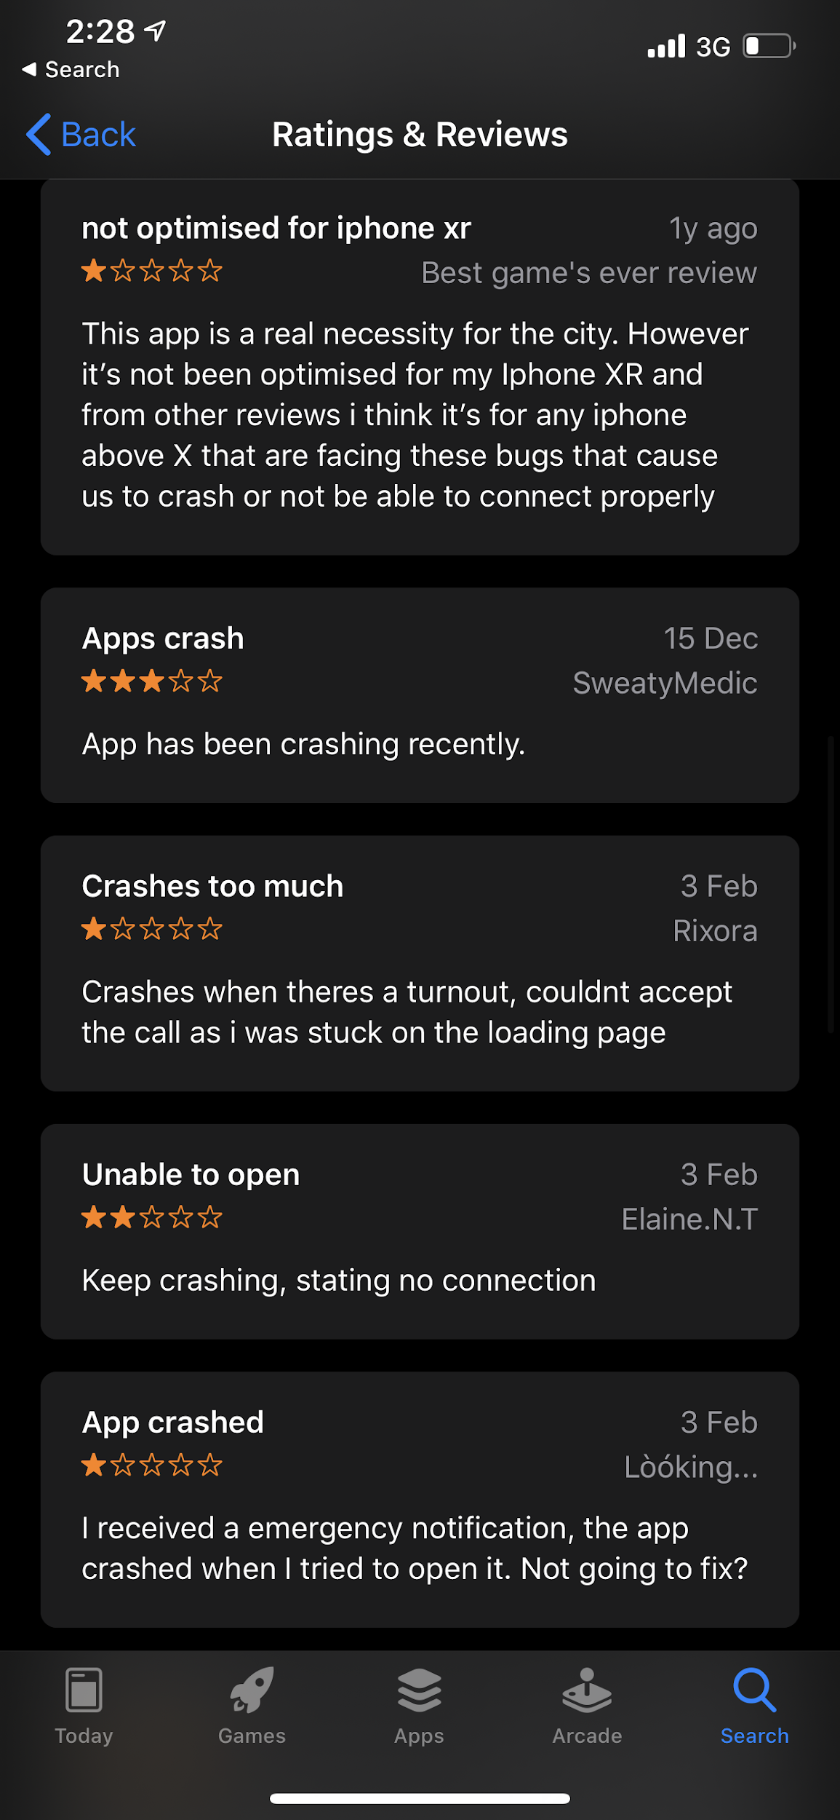
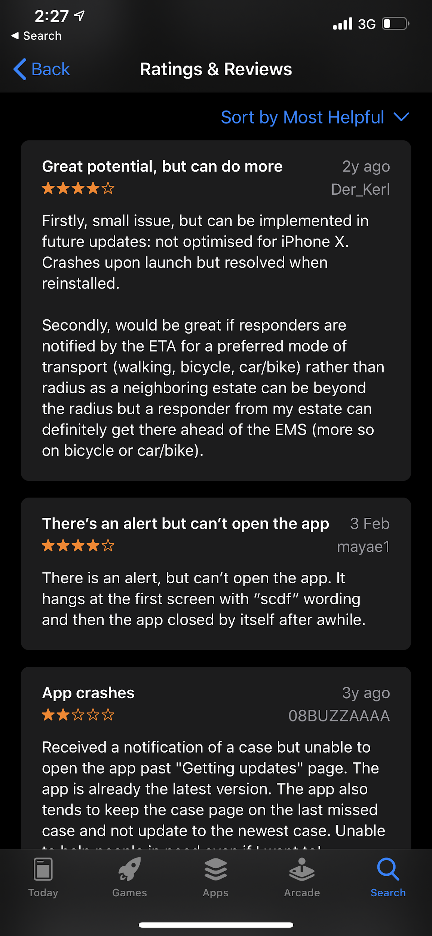
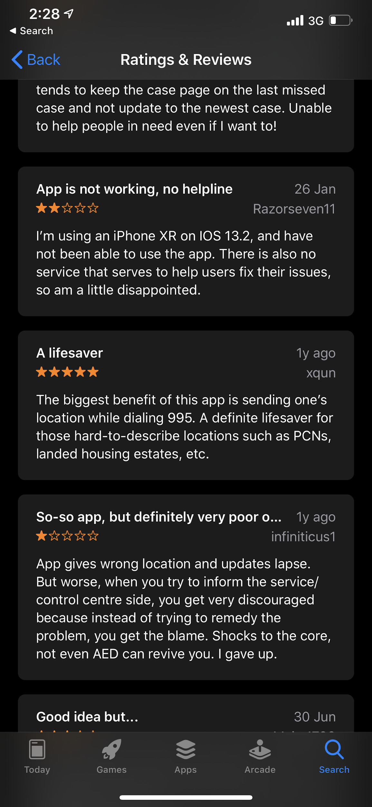
There is already an app for it….
myResponder App - Good! But needs some improvements
Slow: Need to download an app, spread awareness
Slow: Need to register an account
Prone to crashes and compatibility issues

Slide 5
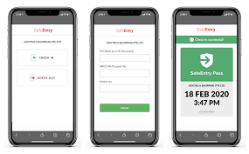
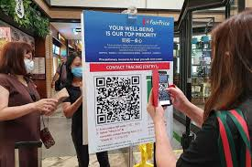

We can learn from...

Slide 6
Introducing SCDF EMERGENCY QR
FAST ADOPTION
NO APP INSTALLATIONS
QUICK EMERGENCY REPORTING
EFFICIENT & EFFECTIVE RESPONSE

